Slide 1





BVSC AGM
13th October 2021
Notes:
Vikki to open?

Slide 2

April 20-March 2021
Hardest year I have known professionally and personally
Amazing staff team and sector
Staff wellbeing, looked after each other
“Living at work”
“We are all in the same storm but we are not in the same boat”
BVSC have delivered incredible achievements this year, some well known and some less visible but all in support of our sector and Bexley communities
Notes:
Vikki to open?

Slide 3


“I’m quite anxious myself at the moment, and its so nice to have a chat with someone, share your life stories and listen to stories about their life. Its nice to make friends even if they are just on the end of the telephone.”
“A positive experience, whilst telephoning befriending has supported vulnerable people, it has also given me a sense f worth to know that I can make a difference at this challenging time.”
“Volunteering has been a life saver for me this year”
“Volunteering with Community Connect has made me realise I am in the wrong job. I’ve been applying for lots of charity roles and hope to make a difference every day rather than just during my phone calls.”
A volunteer just rang to say that she’s really enjoying her match with our client and that she found out that it is her 89th birthday next week! The lady said she never normally has anyone to celebrate with as she doesn’t have any family but now the volunteer is going to call and share some virtual birthday cake with her!
“Doreen* now has a grab rail and a blue badge. She is in such good spirits. Volunteering is an enjoyable pleasure during these difficult times for us all”.

Slide 4


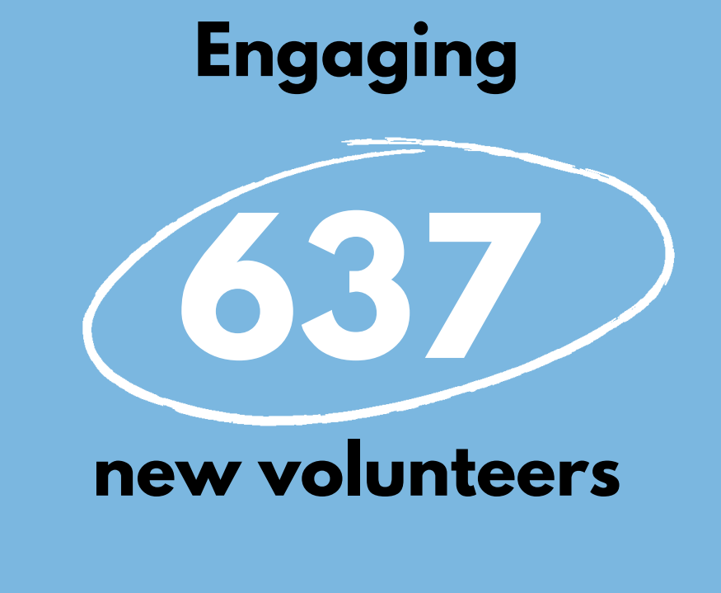
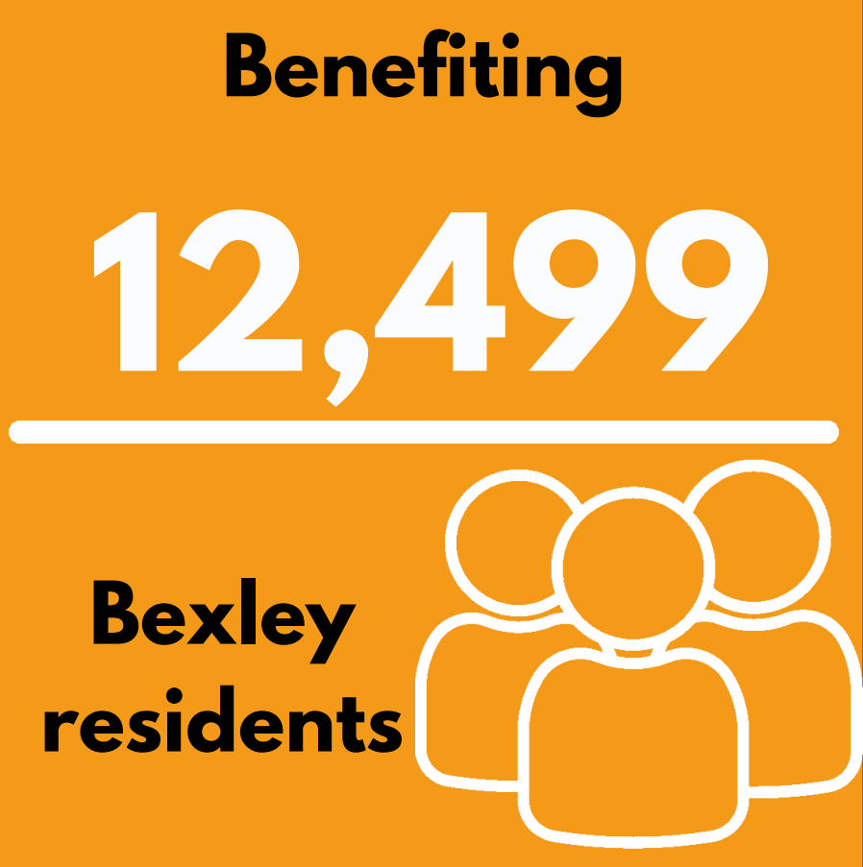
Notes:
Vikki to open?

Slide 5
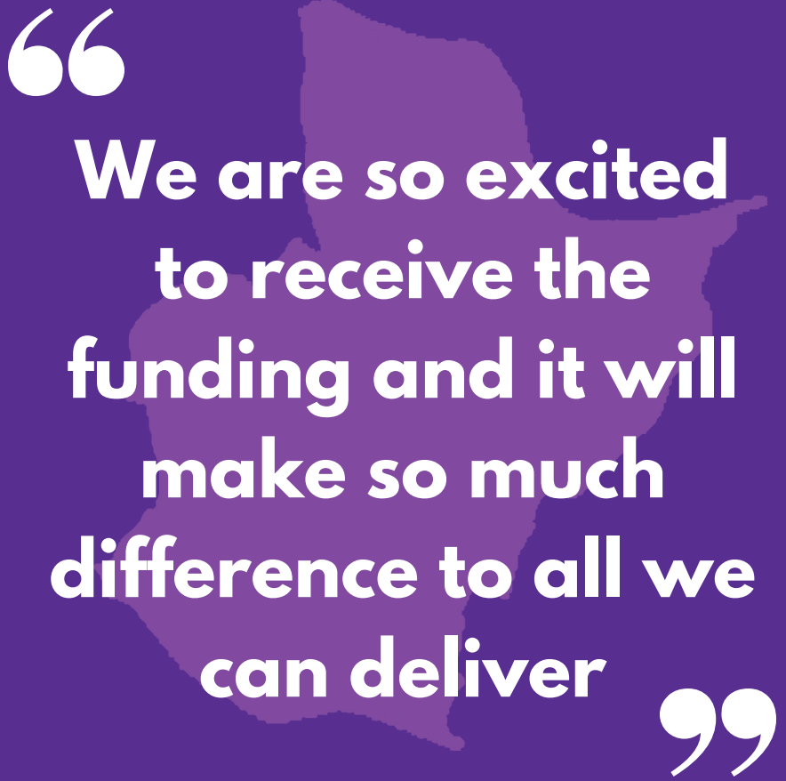
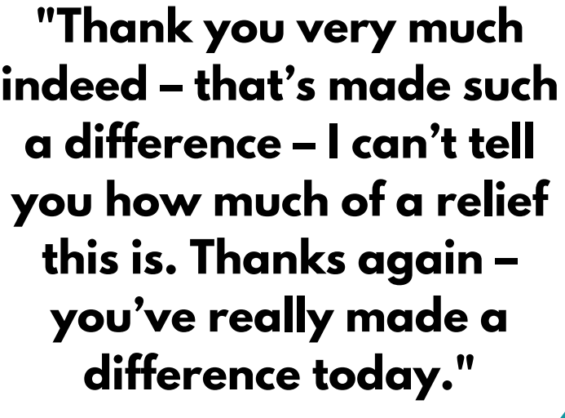
Notes:
Vikki to open?

Slide 6





Notes:
Vikki to open?

Slide 7
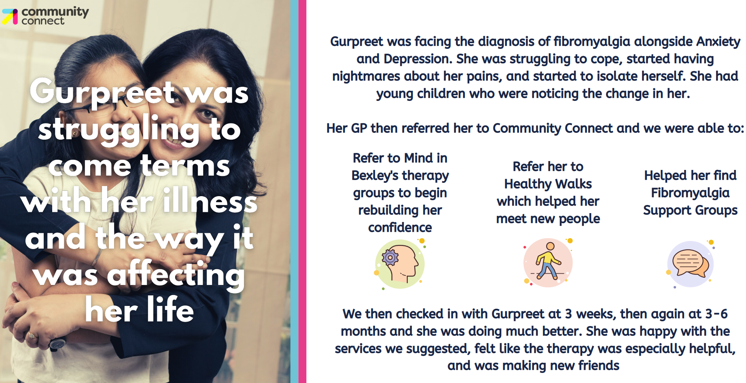
Notes:
Vikki to open?

Slide 8
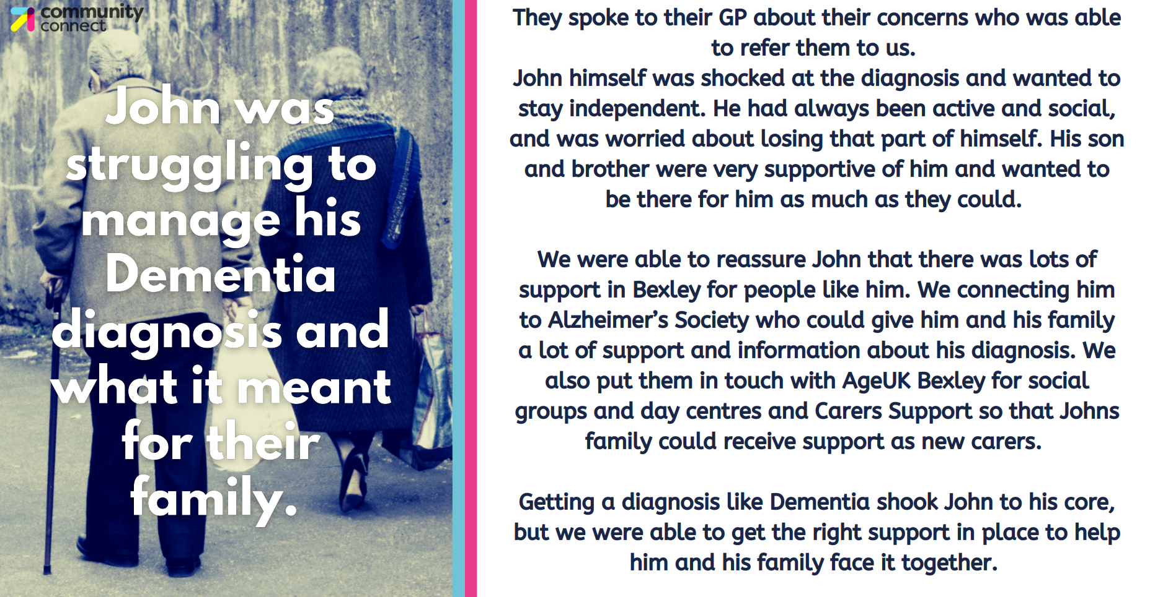
Notes:
Vikki to open?

Slide 9
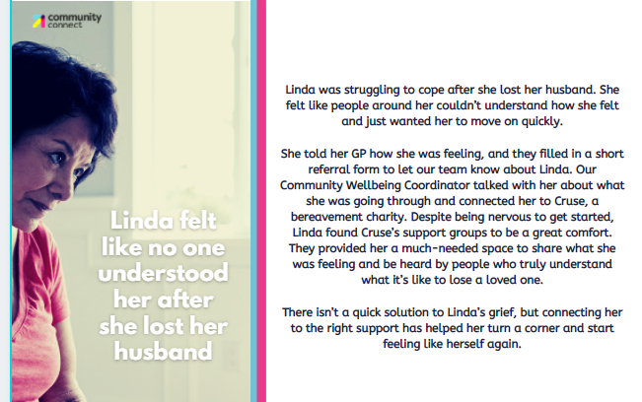
Notes:
Vikki to open?

Slide 10

Bexley Community Lottery: 70 organisations ‘live’ and collecting funds from supporters
520 players supporting Bexley groups
Some organisations with as many as 30-45 supporters buying tickets for them
£34,000 for local good causes
Impact in Action: Over 100 hours of 1-2-1 support, 115 attended training sessions, 87 attended micro training sessions.
‘We're excited to reflect on the difference we make as an organisation, and use this to help us plan for future projects’
Notes:
Vikki to open?

Slide 11
One Bexley: a partnership with 7 local charities working to support people in their communities, with the people they trust and know so they are at the centre of decision making and care.
Networks and partnerships
Over 200 attendees to our networks, development of a Covid-19 directory of VCS services, secured £38,000 in partnership with Moorings and Porchlight to establish a parent carer network to provide support for those who are concerned about their young people presenting with difficult behaviours.
William Kendall small grants
15 orgs received grants ranging from weekly supervision for counsellors; IT equipment; new lighting; transport costs for a food bank; website development; volunteering recruitment campaign; memory sharing group and disabled facilities. £19355 was allocated to Bexley groups.
Notes:
Vikki to open?

Slide 12

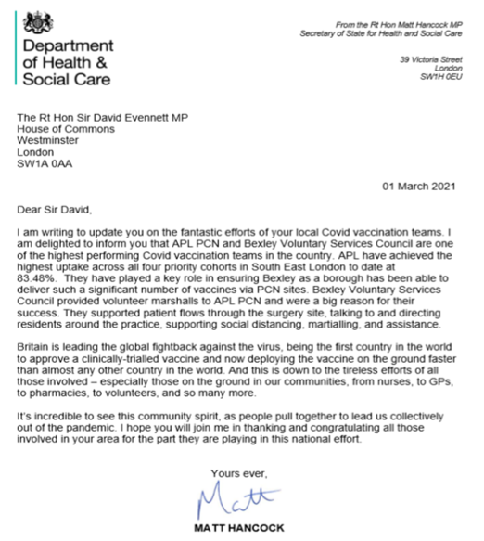
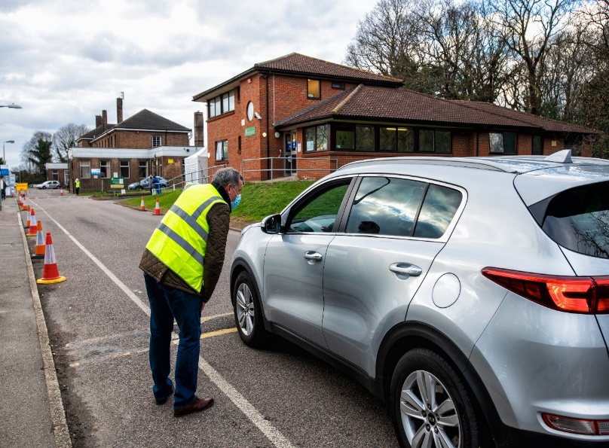
“Just wanted to say how much I enjoyed my session today. Firstly it helped being indoors lol but I loved meeting everyone and having a good chat with the people waiting. Felt good being useful!”
“I completed my first shift last night. I never thought I’d be so happy to stand outside in the rain. I had lots of ‘thank you’s’ from people who were very appreciative of the support received and I was very happy to be of help”.

Slide 13
Update: Volunteer Vaccine Marshall December 2020- present
Number of volunteers recruited and trained: 249
Total hours volunteers have given: 6870
Supported 5 vaccine centres
Number of 2 hour slots filled: 775
Notes:
Vikki to open?

Slide 14
BVSC: our next steps
To support our sector to navigate choppy waters ahead; to be as strong as they can be to support Bexley people and communities
Leadership
Inequalities
Digital inclusion
Sector support
Social Prescribing
Volunteering for all
Development
One Bexley
Notes:
Vikki to open?

Slide 15





Thank you to:
Our sector
Partners
Funders
Board of Trustees
Staff and volunteers
Notes:
Vikki to open?

